Slide 1
Python Sets
DVT101 – Lecture 27
- By Dataverse Tutorials

Slide 2
Introduction
What is a Python Set?
Why Sets exist (uniqueness, speed, membership checks)
Real-life analogy: Unique ID list
Where sets are used (data cleaning, analytics, security)

Slide 3
Core Properties of Sets
Unordered collection
No duplicate elements
Mutable (but elements must be immutable)
Unindexed (no positions)
Implemented using hash tables

Slide 4

Creating a Set (Curly Braces)
Create set using { }
Automatic duplicate removal
Unordered output
Program concept: uniqueness & hash-based storage

Slide 5
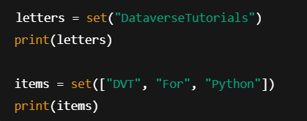
Creating a Set using set()
From string
From list
From tuple
From dictionary (keys only)
Program concept: iterable → unique elements

Slide 6
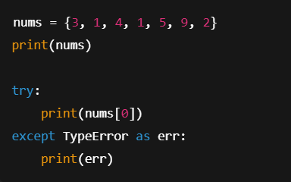
Unordered, Unindexed & Mutability
Order not guaranteed
No indexing allowed
Duplicate auto-removal
TypeError on index access
Program concept: hash structure behavior

Slide 7
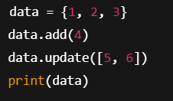
Adding Elements to a Set
add() → single item
update() → multiple items
Mutability shown
Program concept: dynamic growth

Slide 8
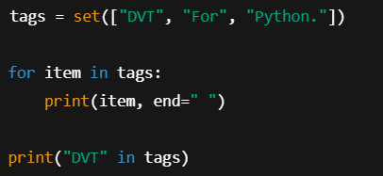
Accessing Elements in a Set
Loop using for
Membership check using in
Unordered traversal
Program concept: iteration without index

Slide 9
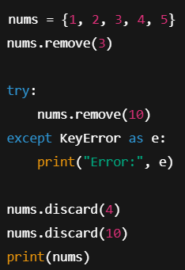
Removing Elements (remove & discard)
remove() → error if missing
discard() → safe remove
Error handling demo
Program concept: controlled deletion

Slide 10
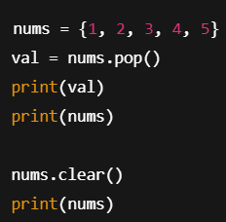
Removing Elements (pop & clear)
pop() → random element
Error on empty set
clear() → remove all
Program concept: memory cleanup

Slide 11

Frozen Sets
Immutable version of set
Cannot add/remove elements
Hashable
Program concept: constant data structure

Slide 12
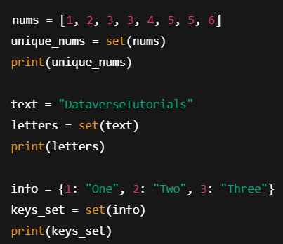
Typecasting into Sets
List → set
String → set
Dictionary → set (keys)
Duplicate auto-removal
Program concept: data cleaning

Slide 13
Real-World & Industry Use Cases
Removing duplicates from datasets
Membership validation
Network security whitelists
Data analytics pipelines
Recommendation systems

Slide 14
Summary & Key Takeaways
Sets = unique, unordered, fast
No duplicates, no indexing
Add, remove, check, iterate
Frozen sets for immutability
Powerful tool for data processing

Slide 15


